Slide 1

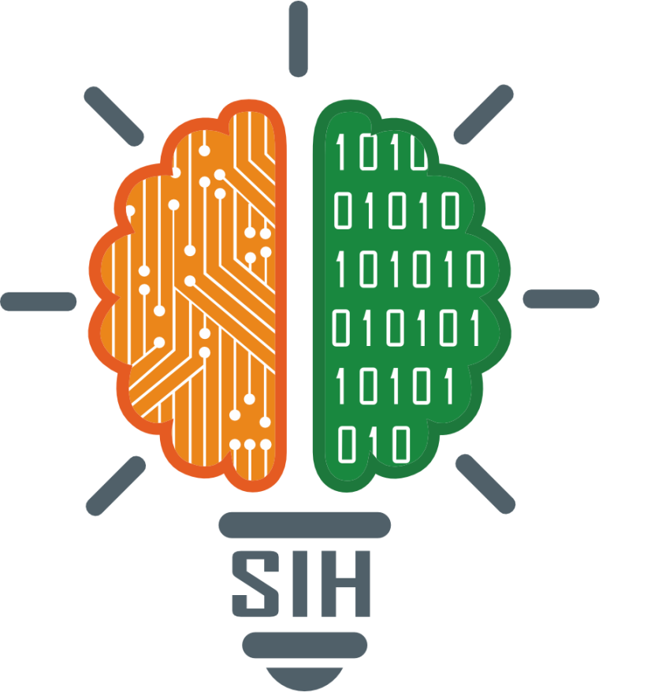
SMART INDIA HACKATHON 2024
TITLE PAGE
Problem Statement ID –1656
Problem Statement Title- Development of a mobile application to provide recreational suitability information of beach locations across India.
Theme- Travel&Tourism
PS Category- Software
Team ID-
Team Name-TECH TITANS

Slide 2
IDEA TITLE
TECH
TITANS
PROBLEM RESOLUTION
Data Accuracy and Reliability
Regular Updates: Implement a system for frequent updates and validation of beach information.
User Feedback: Enable users to report inaccuracies and update data accordingly.
IDEA/SOLUTION
Development of a mobile application to provide recreational suitability information of beach locations across India.
User Interface and Experience Issues
User Testing: Conduct usability testing to identify and address navigation issues.
Design Iteration: Make iterative improvements based on feedback to simplify the user experience.
Interactive Beach Map
Personalized Recommendations
Real-Time Updates
User-Generated Content
Local Insights and Tips
.
Unique Value Prepositions
Live, Crowdsourced Beach Info: Up-to-date reviews and conditions from real users.
Virtual Beach Previews: Explore 360-degree tours of beaches before you go.

Slide 3
TECHNICAL APPROACH
TECH
TITANS
USER INTERFACE
Front-End Development
Creating the user interface (UI) and user experience (UX). Technologies include React Native, Flutter.
Back-End Development
Handling server-side logic, database interactions, and application functionality. Technologies include Node.js, Django.
Database Management
Storing and managing application data. Technologies include, MySQL,.
APIs and Integration
Connecting the app with external services and data sources. Includes integration with third-party APIs for weather, maps, and other functionalities.
Cloud Services
Providing scalable infrastructure for hosting, storage, and computing. Providers include AWS, Google Cloud, and Azure.
FRONT-END
API INTEGRATION
BACK-END
DATABASE MANAGEMAENT
CLOUD SERVICES/CDN

Slide 4
FEASIBILITY AND VIABILITY
TECH
TITANS
Feasibility
Technology Availability: The required technologies, such as GPS, mapping APIs (Google Maps, OpenStreetMap), and mobile app development frameworks (React Native, Flutter), are readily available and mature.
Data Availability: While historical data on water quality and other beach parameters might be limited in some regions, it can be progressively collected and updated through partnerships with local authorities, environmental agencies, and citizen science initiatives
Market Demand: The increasing popularity of beach tourism in India indicates a strong market demand for such an app.
Viability
Target Audience: The app can target a wide range of users, including tourists, locals, and beach enthusiasts.
Revenue Generation: A combination of in-app advertising, premium features, and partnerships can ensure a sustainable revenue model.
Partnerships: Collaborations with government agencies, tourism boards, and environmental organizations can enhance the app's credibility and reach.

Slide 5
IMPACT AND BENEFITS
TECH
TITANS
Potential impact on the target audience
Benefits of the solution(social,economic, environmental, etc.)

Slide 6
RESEARCH AND REFERENCES
TECH
TITANS
Details / Links of the reference and research work

Slide 7
IMPORTANT INSTRUCTIONS
Please ensure below pointers are met while submitting the Idea PPT:
Kindly keep the maximum slides limit up to six (6). ( Including the title slide)
Try to avoid paragraphs and post your idea in points /diagrams / Infographics /pictures
Keep your explanation precise and easy to understand
Idea should be unique and novel.
You can only use provided template for making the PPT without changing the idea details pointers (mentioned in previous slides).
You need to save the file in PDF and upload the same on portal. No PPT, Word Doc or any other format will be supported.
Note - You can delete this slide (Important Pointers) when you upload the details of your idea on SIH portal.

